Slide 1
Zookeeper
By
Prof. Prakash Patel
Asst.Prof.-it dept.
git

Slide 2
Zookeeper
ZooKeeper is a distributed co-ordination service to manage large set of hosts.
It allows developers to focus on core application logic without worrying about the distributed nature of the application.
Apache ZooKeeper became a standard for organized service used by Hadoop, HBase, and other distributed frameworks.
It is a service used by a cluster (group of nodes) to coordinate between themselves and maintain shared data with robust synchronization techniques.
ZooKeeper is itself a distributed application providing services for writing a distributed application.

Slide 3
Services of Zookeeper
Naming service – Identifying the nodes in a cluster by name. It is similar to DNS, but for nodes.
Configuration management – Latest and up-to-date configuration information of the system for a joining node.
Cluster management – Joining / leaving of a node in a cluster and node status at real time.
Leader election – Electing a node as leader for coordination purpose.
Locking and synchronization service – Locking the data while modifying it. This mechanism helps you in automatic fail recovery while connecting other distributed applications like Apache HBase.
Highly reliable data registry – Availability of data even when one or a few nodes are down.

Slide 4
Benefits of ZooKeeper
Simple distributed coordination process
Synchronization – Mutual exclusion and co-operation between server processes. This process helps in Apache HBase for configuration management.
Ordered Messages
Serialization – Encode the data according to specific rules. Ensure your application runs consistently. This approach can be used in MapReduce to coordinate queue to execute running threads.
Reliability
Atomicity – Data transfer either succeed or fail completely, but no transaction is partial.

Slide 5
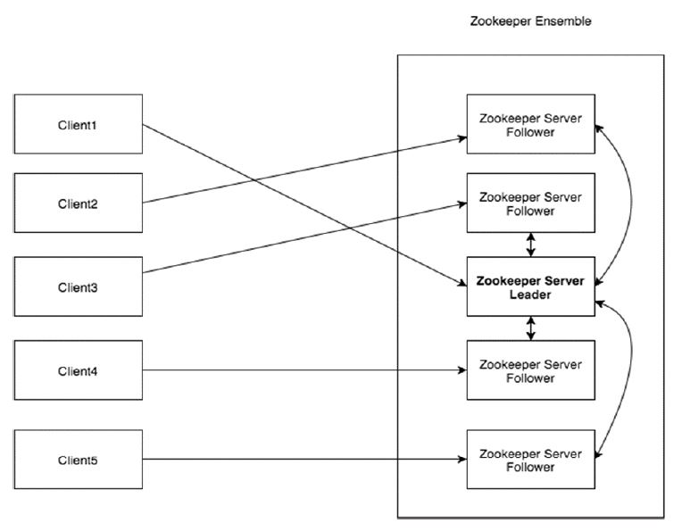
Architecture of ZOOKEEPER

Slide 6
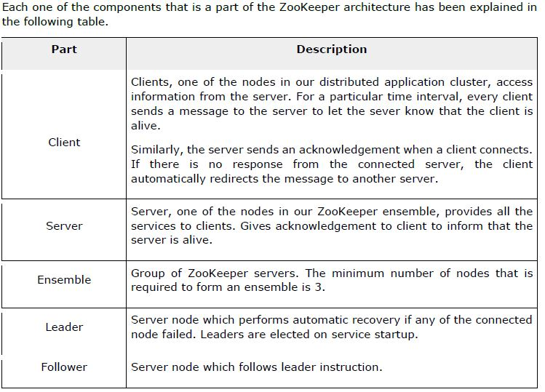
Zookeeper Components

Slide 7
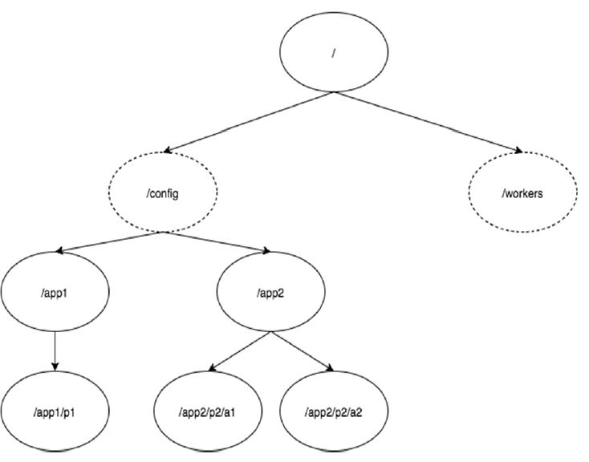
Hierarchical Namespace
The following diagram depicts the tree structure of ZooKeeper file system.

Slide 8
Sessions
Sessions are very important for the operation of ZooKeeper.
Requests in a session are executed in FIFO order.
Once a client connects to a server, the session will be established and a session id is assigned to the client.
The client sends heartbeats at a particular time interval to keep the session valid.
If the ZooKeeper ensemble does not receive heartbeats from a client for more than the period (session timeout) specified at the starting of the service, it decides that the client died.
Session timeouts are usually represented in milliseconds. When a session ends for any reason, the ephemeral znodes created during that session also get deleted.

Slide 9
Watches
Watches are a simple mechanism for the client to get notifications about the changes in the ZooKeeper ensemble.
Clients can set watches while reading a particular znode.
Watches send a notification to the registered client for any of the znode (on which client registers) changes.
Watches are triggered only once.
If a client wants a notification again, it must be done through another read operation.
When a connection session is expired, the client will be disconnected from the server and the associated watches are also removed.

